Slide 1
PRESENTATION ON INTERNSHIP PROJECT
P665-CROWDFUNDING PROJECT
PPT
BY
Durgesh Chavan

Slide 2
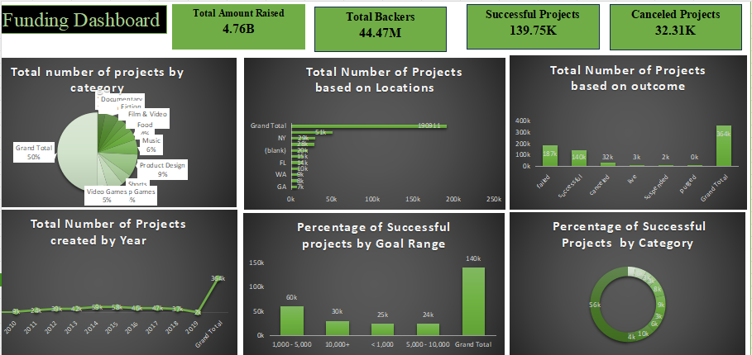
EXCEL DASHBOARD

Slide 3
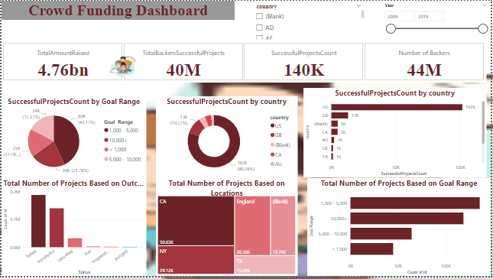
POWERBI DASHBOARD

Slide 4
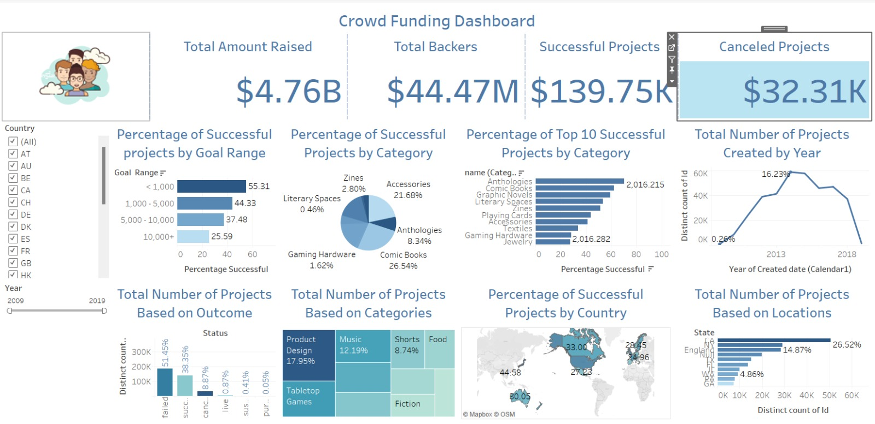
TABLEAU DASHBOARD

Slide 5
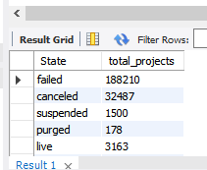
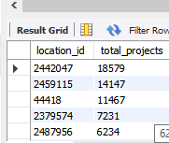
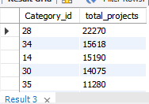
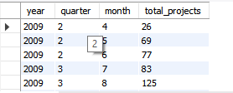





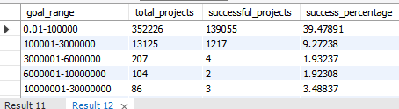
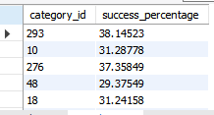
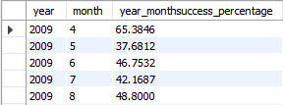
MYSQL ANSWERS

Slide 6
TASK PERFORMED
PROJECT
Crowdfunding is the practice of funding a project or venture by raising small amounts of money from a large number of people, typically via the Internet.
Converted Date Fields from Epoch to Natural Time
Calculated Projects KPI’S like Total Projects by Outcome:,Total Projects by Location,Total Projects by Category,Total Projects by Time Period
Successful Projects Metrics like Total Amount Raised,Total Number of Backers,Average Number of Days
Top Successful Projects like Top Projects by Backers,Top Projects by Amount Raised
Calculate Success Percentages,Overall Success Percentage,Success by Category,Success by Time,Success by Goal Range:

Slide 7
ABOUT PROJECT EXPERIENCE
Real time experience.
Projects are developed under the trainer’s guidance.
The overall experience was worth the time spent there motivated us to work effectively and precisely.
To conclude, this internship project was very beneficial to us as I learned a lot, it gave me the experience of working in a real time envirorment.
We faced problems while executing queries in mysql and tried to resolve it.

Slide 8
THANK YOU

